Slide 1
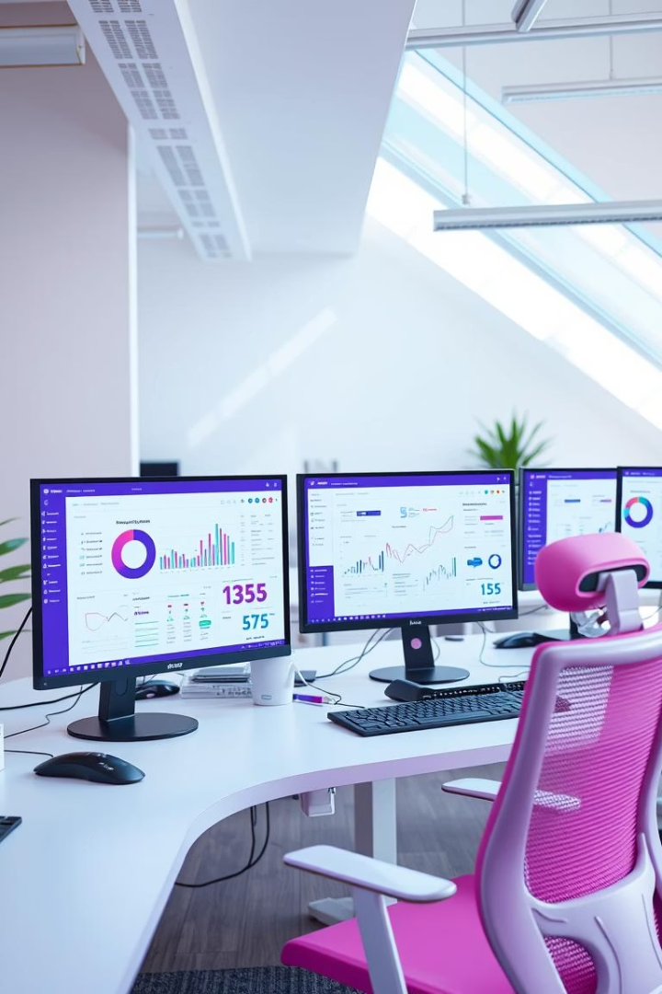
INBOX TO INSIGHT
Smart Complaint Handling with UiPath & GenAI
Transforming complaint management with AI-powered automation.

Slide 2
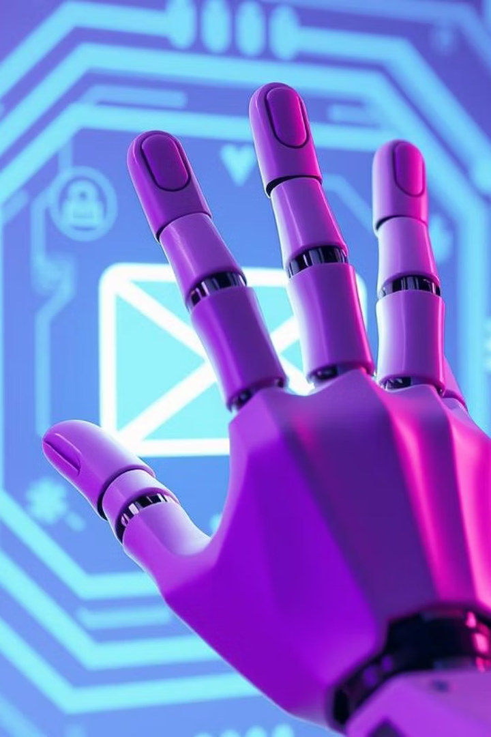



Project Overview
Smart Automation Bot
Handles customer complaints efficiently
UiPath + OpenAI
Processes emails end-to-end
Our Goals
Reduce manual effort, speed responses, log interactions, complaint trends through a live dashboard.

Slide 3

Why This Problem Matters
High Email Volume
Service Delays
Inconsistent Handling
Teams struggle to keep up
Many incoming complaint emails
Lack of data visibility and missed issues

Slide 4
GenAI + UiPath Workflow
Email Retrieval
AI Classification
Automated Replies
Logging & Forwarding
UiPath connects to Gmail for unread complaints
OpenAI categorizes issues like Billing or Feedback
Structured responses based on category
Complaints logged in Excel; select cases forwarded

Slide 5
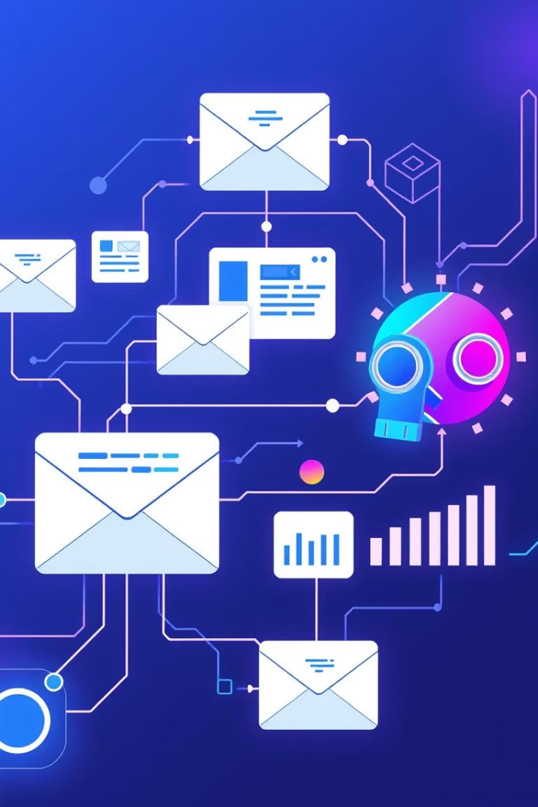
Automation in Action
Email Received
1
2
AI Analyzes & Categorizes
Auto-reply Sent
3
4
Details Logged in Excel
Dashboard Auto-refreshes
5
6
High-priority Forwarded

Slide 6





Lessons from Building the Bot
OpenAI Integration
Sending and processing AI requests though UiPath
Decision Workflows
Using AI output effectively
Excel Dashboards
Dynamic pivot tables and formatting
Human Oversight
Ethical automation design

Slide 7

Real-World Value
90%
Faster Resolution
For common complaints
Reduced
Manual Workload
Fewer errors and less noise
Improved
Customer Experience
Custom replies and clarity
Centralized
Complaint Log
Real-time visibility for managers

Slide 8

Responsible Use of GenAI
No Critical Decisions
1
AI excludes refunds and account changes
2
Human Support
Product defects routed to humans
AI Assistance
3
Only categorization and templated replies
4
Clear Communication
Customers know when human follow-up is needed
Ethical Design
5
Human-in-the-loop practices emphasized

Slide 9

Conclusion and Scalability
Scalability
Easily scales to handle more emails or diverse input channels.
Integration
Integrates seamlessly with CRM platforms like Zendesk and Freshdesk.
Application
Applicable to various domains: HR, IT support, procurement requests.
Benefits
Delivers cost savings and enhances overall customer service quality.

Slide 10

Thank You
Any questions?

